Slide 2
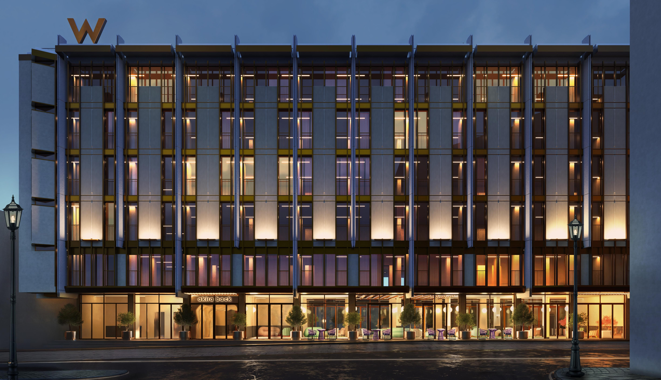

Slide 3
MARRIOTT CONFIDENTIAL AND PROPRIETARY INFORMATION

Slide 4
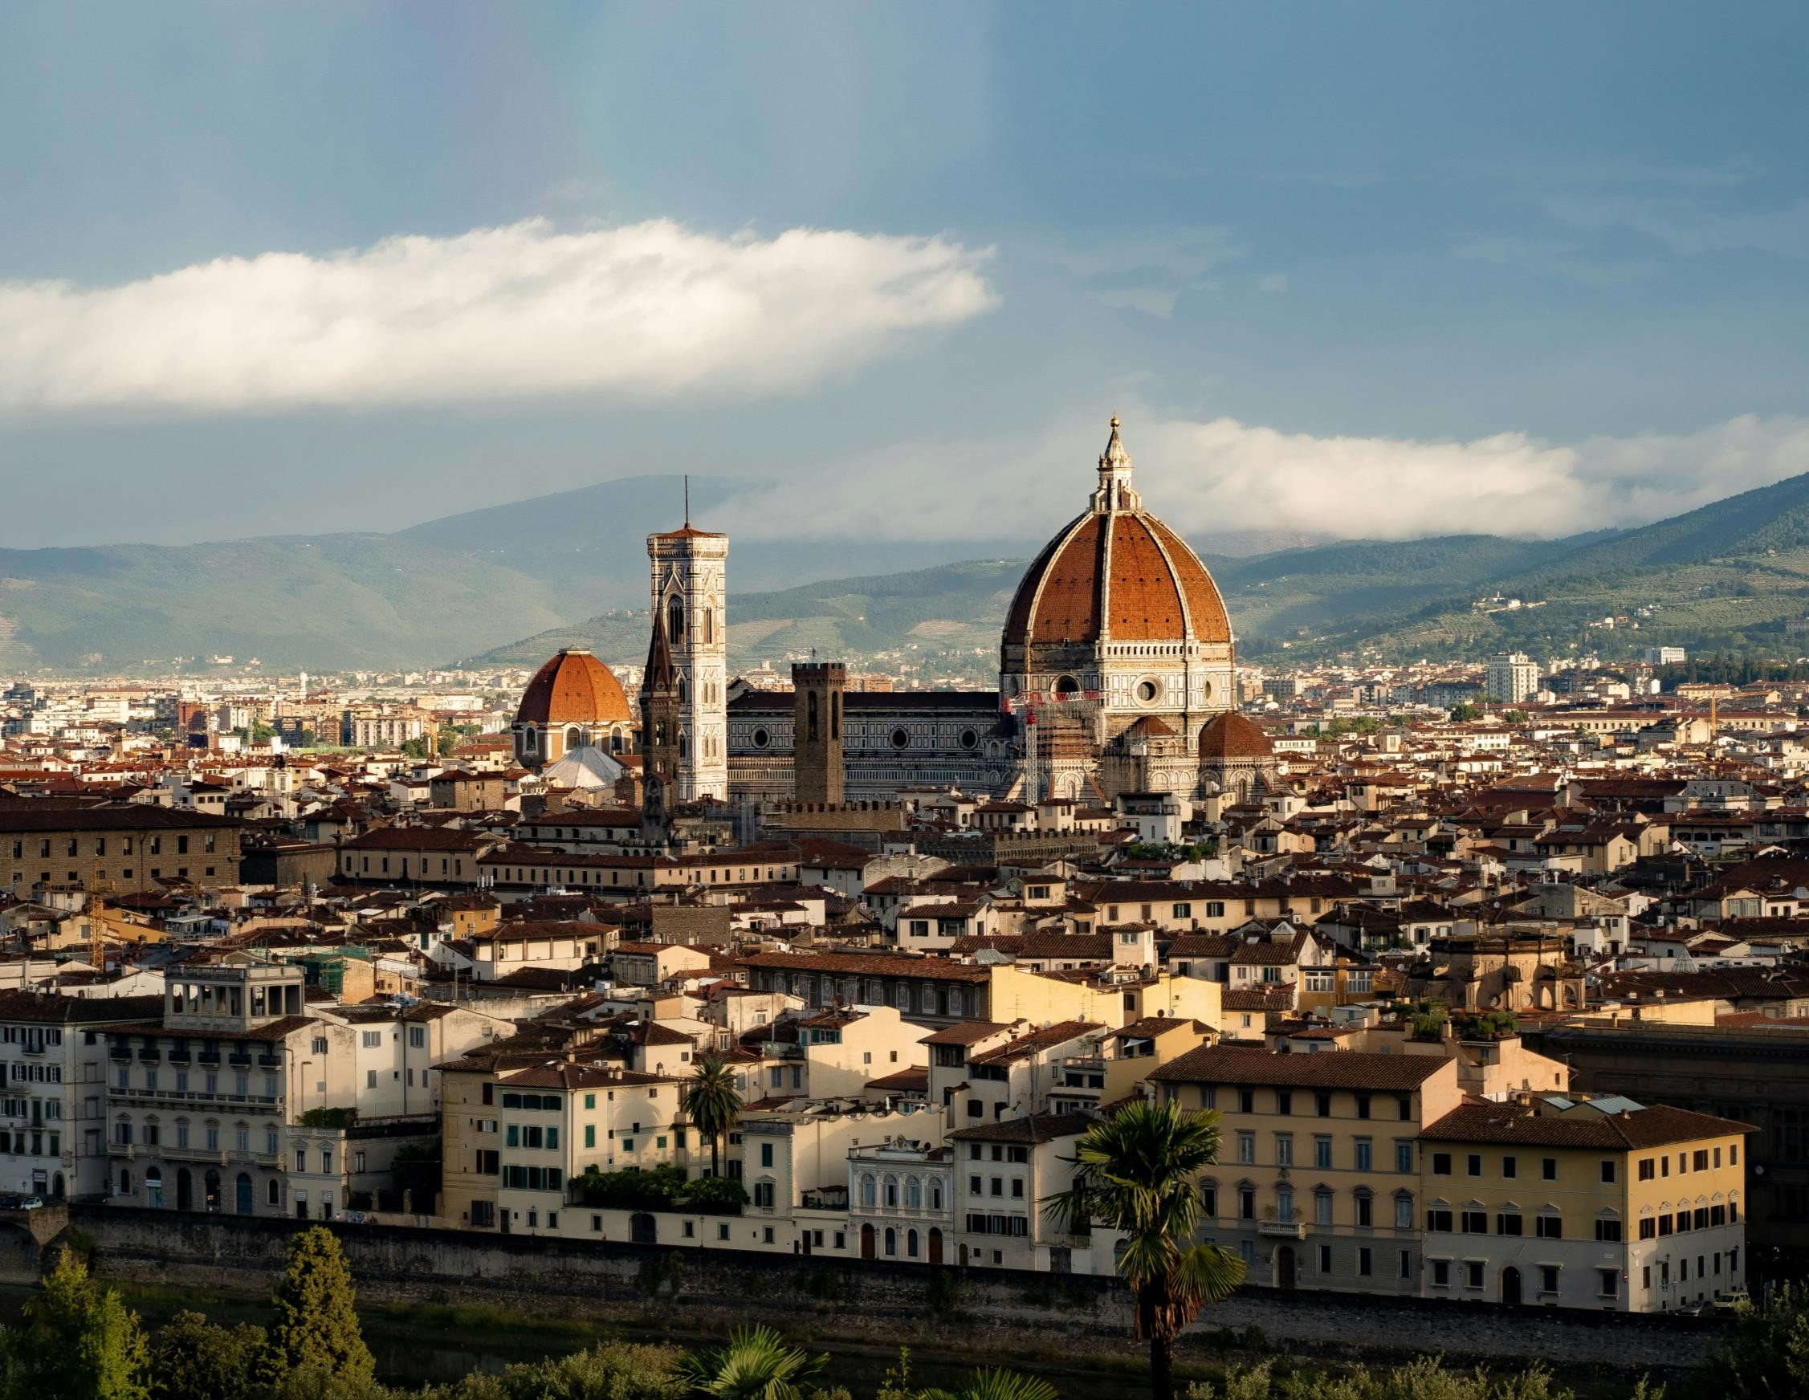
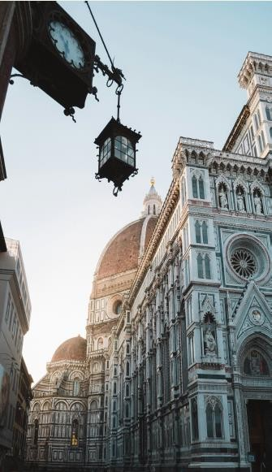
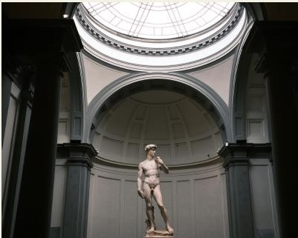
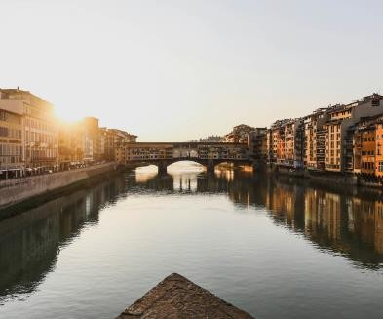
MARRIOTT CONFIDENTIAL AND PROPRIETARY INFORMATION

Slide 5
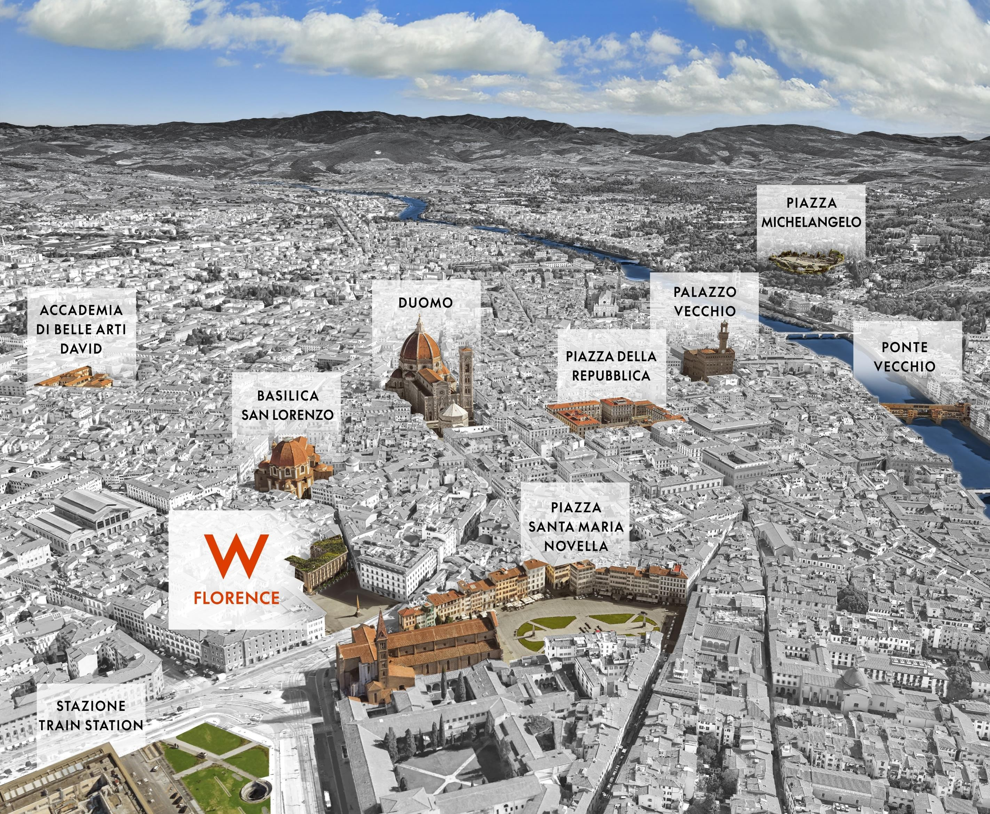
MARRIOTT CONFIDENTIAL AND PROPRIETARY INFORMATION
•
•
•
•
•
•
•
•
•

Slide 6
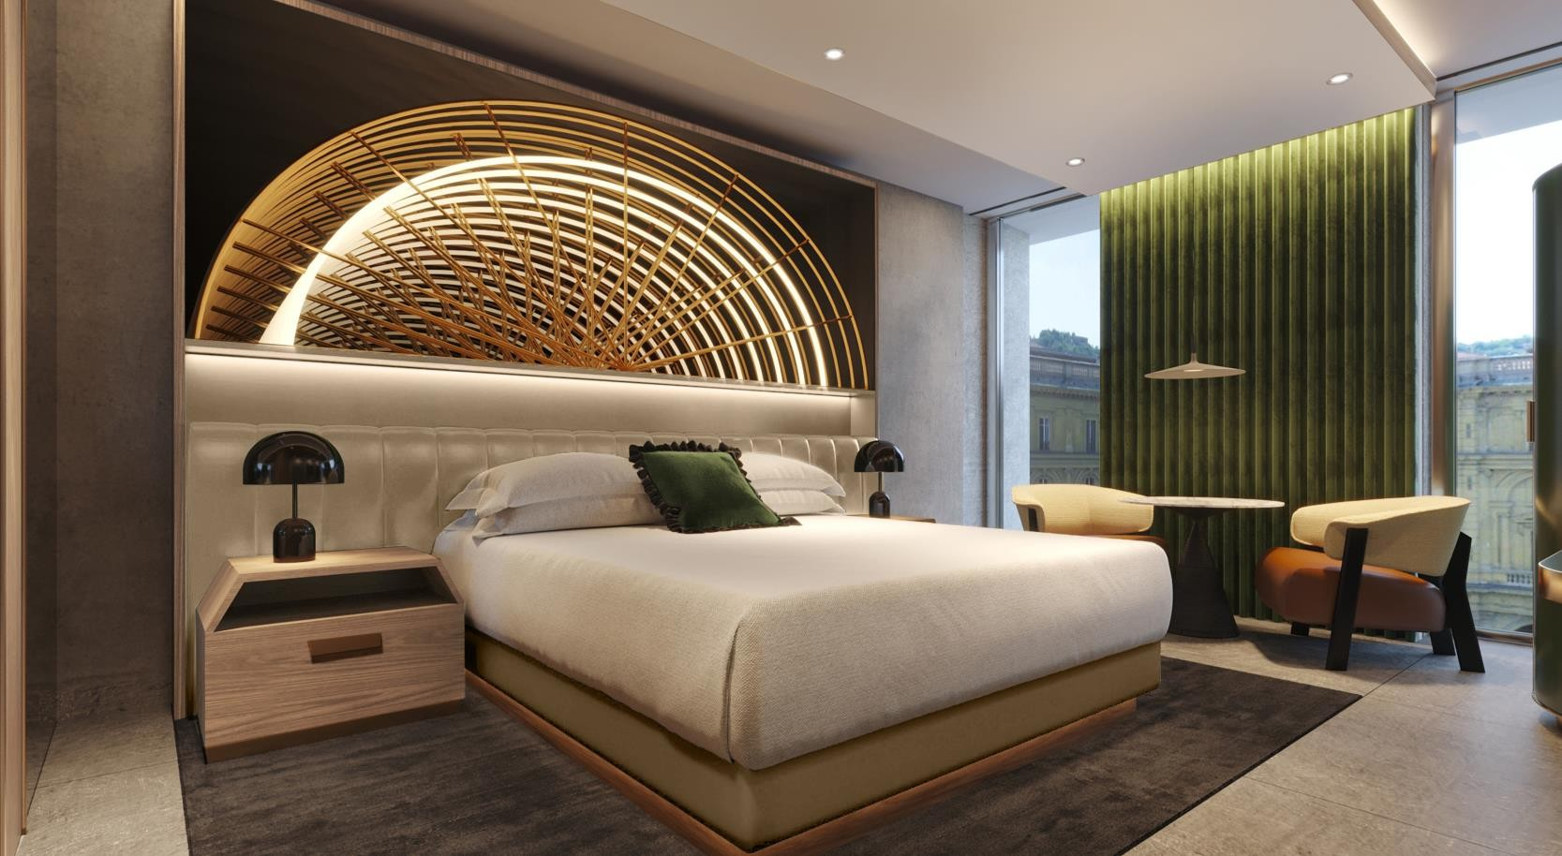
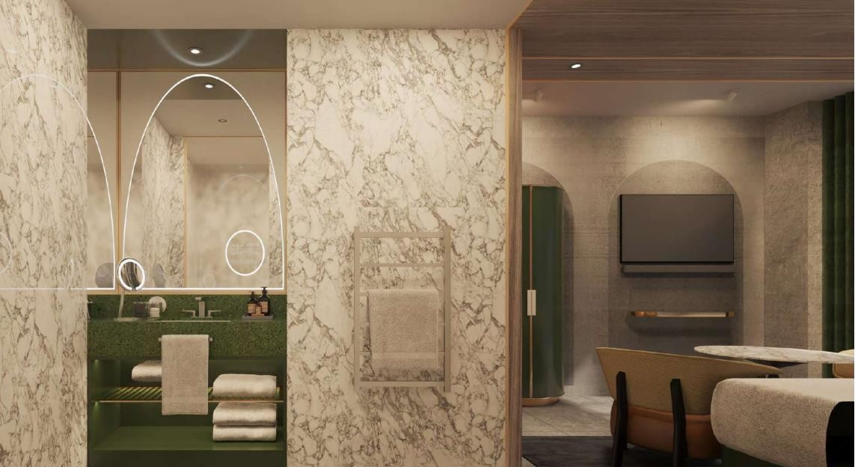
MARRIOTT CONFIDENTIAL AND PROPRIETARY INFORMATION

Slide 7
MARRIOTT CONFIDENTIAL AND PROPRIETARY INFORMATION

Slide 8
MARRIOTT CONFIDENTIAL AND PROPRIETARY INFORMATION

Slide 9
MARRIOTT CONFIDENTI
AL AND PROPRIETARY INFORMATION
AL AND PROPRIETARY INFORMATION
•
MARRIOTT CONFIDENTI

Slide 10
MARRIOTT CONFIDENTI
AL AND PROPRIETARY INFORMATION
AL AND PROPRIETARY INFORMATION
•
•
•
•
MARRIOTT CONFIDENTI

Slide 11
MARRIOTT CONFIDENTI
AL AND PROPRIETARY INFORMATION
AL AND PROPRIETARY INFORMATION
•
•
MARRIOTT CONFIDENTI

Slide 12
MARRIOTT CONFIDENTI
AL AND PROPRIETARY INFORMATION
AL AND PROPRIETARY INFORMATION
•
MARRIOTT CONFIDENTI

Slide 13
MARRIOTT CONFIDENTIAL AND PROPRIETARY INFORMATION
•
•
•

Slide 14
MARRIOTT CONFIDENTIAL AND PROPRIETARY INFORMATION

Slide 15
MEET OUR SALES TEAM
Lucas Ambrosione
Director of Sales & Distribution
Valentina Marchesano
Senior Sales Manager
lucas.ambrosione@whotels.com
+393357375958
valentina.marchesano@whotels.com
+393316779391

